Slide 1


MadLibs
CoderDojo Clark
In Java!

Slide 2
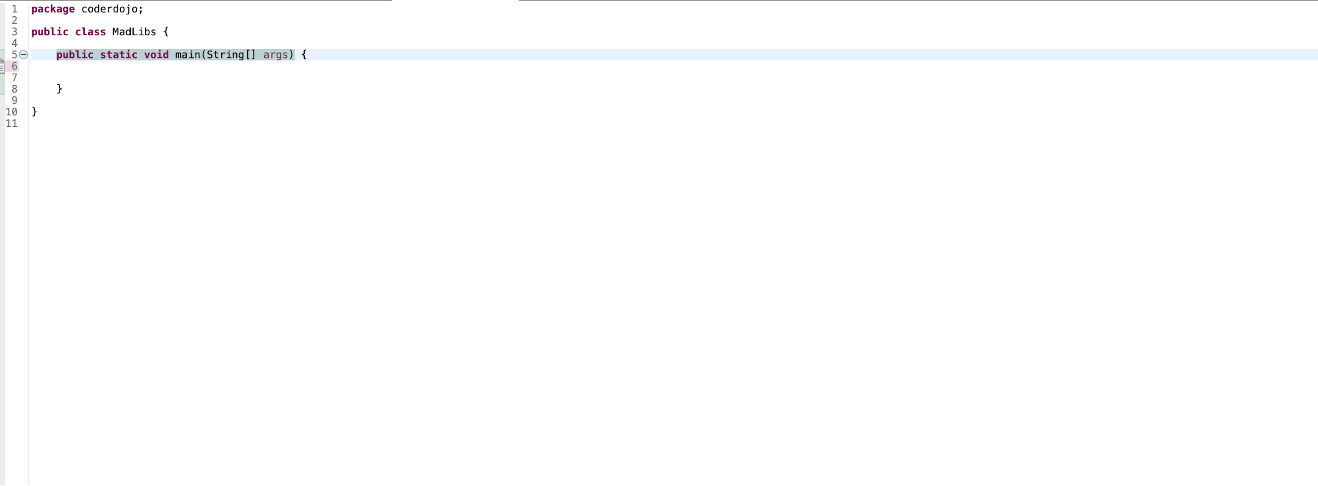
Create a new class (I used Eclipse)
**Note: Make sure to include public static void main(String[] args)

Slide 3
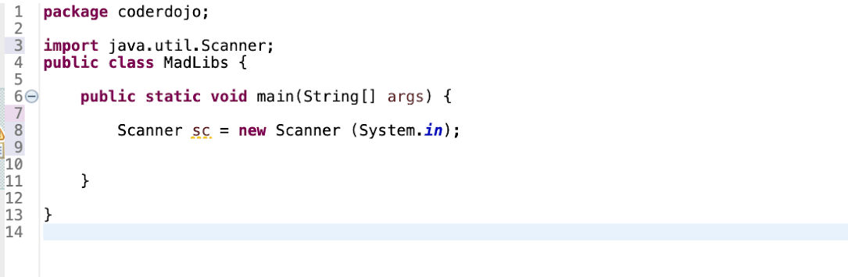
Import Scanner (to take in user input)
The Scanner is an object -- which is a structure that contains instructions and other features to help us take input from the user.

Slide 4
Enter in your Mad Libs template!
My template is shown above. You can search up Mad Libs templates on google for inspiration!

Slide 5
Create places where your user can input values
In order to do this, we will need to create variables that can hold the input from the user. For this project, most or all of your variables will be Strings since Mad Libs usually involves entering a word. Here is an example of an input that I included:
This code gives the user instructions for what to enter
** Make sure to repeat this step for the number of blanks you have in your Mad Libs.
If the user needs to enter in ten words, make sure you repeat this step 10 times. Name the variable a DIFFERENT name each time.
Here, I named the variable that will contain the user input
This is the code that we need to include to take in input from the user

Slide 6
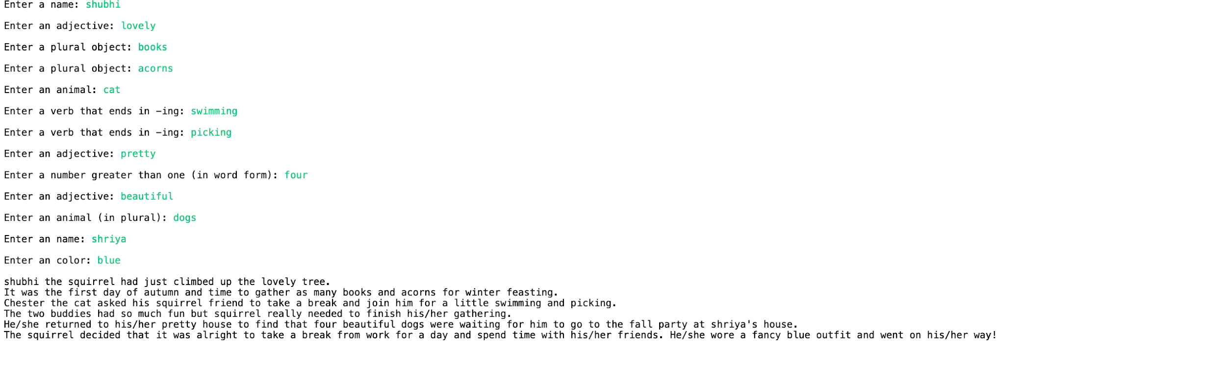
Run your program!

Slide 7
Thanks
CoderDojo Clark
@coderdojoclark
Coderdojo Clark
Send your projects to:
clark.coderdojo@gmail.com
Visit our website!
coderdojoclarkedison.com
Please keep this slide for attribution.

